Slide 1

Movie App – Full-Stack Web Application
Built with React, Node.js, Express, MongoDB, and TMDB API
Presented by: Muhammad Sannan
Date: [Insert Date]

Slide 2





Key Technologies
Frontend
Backend
Database
React
Node.js
MongoDB (with Mongoose ODM)
Bootstrap
Express.js
Custom CSS
Authentication
API
JWT
The Movie Database (TMDB)
bcrypt

Slide 3

User Authentication
Login & Signup
with secure password hashing (bcrypt).
JWT-based Authentication
to protect routes and manage sessions.
Role-based Access Control
(e.g., user vs. admin if applicable).

Slide 4
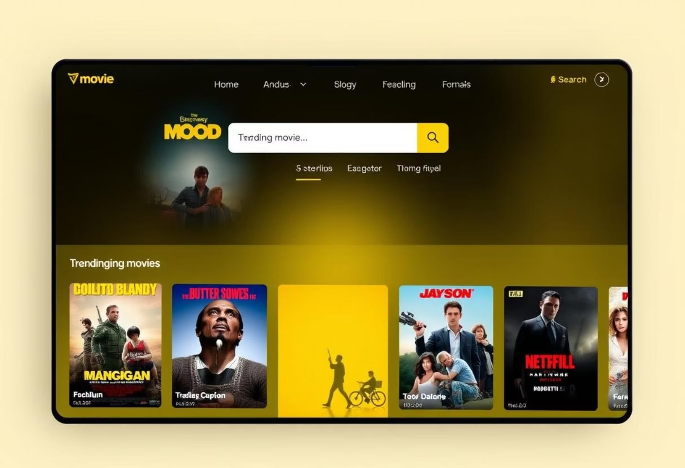
Homepage & Search
Beautiful landing page showcasing trending movies/shows.
Search Functionality:
Real-time search using TMDB.
Redirects to search.html or /search page with results.
Responsive design with movie posters, titles, and ratings.

Slide 5

Movie & TV Show Details
Click on any movie/show to open a detailed page.
Displays:
Poster, title, rating, overview.
Genres, release date, runtime.
Cast and crew (fetched from TMDB).
Episodes list for TV shows.

Slide 6
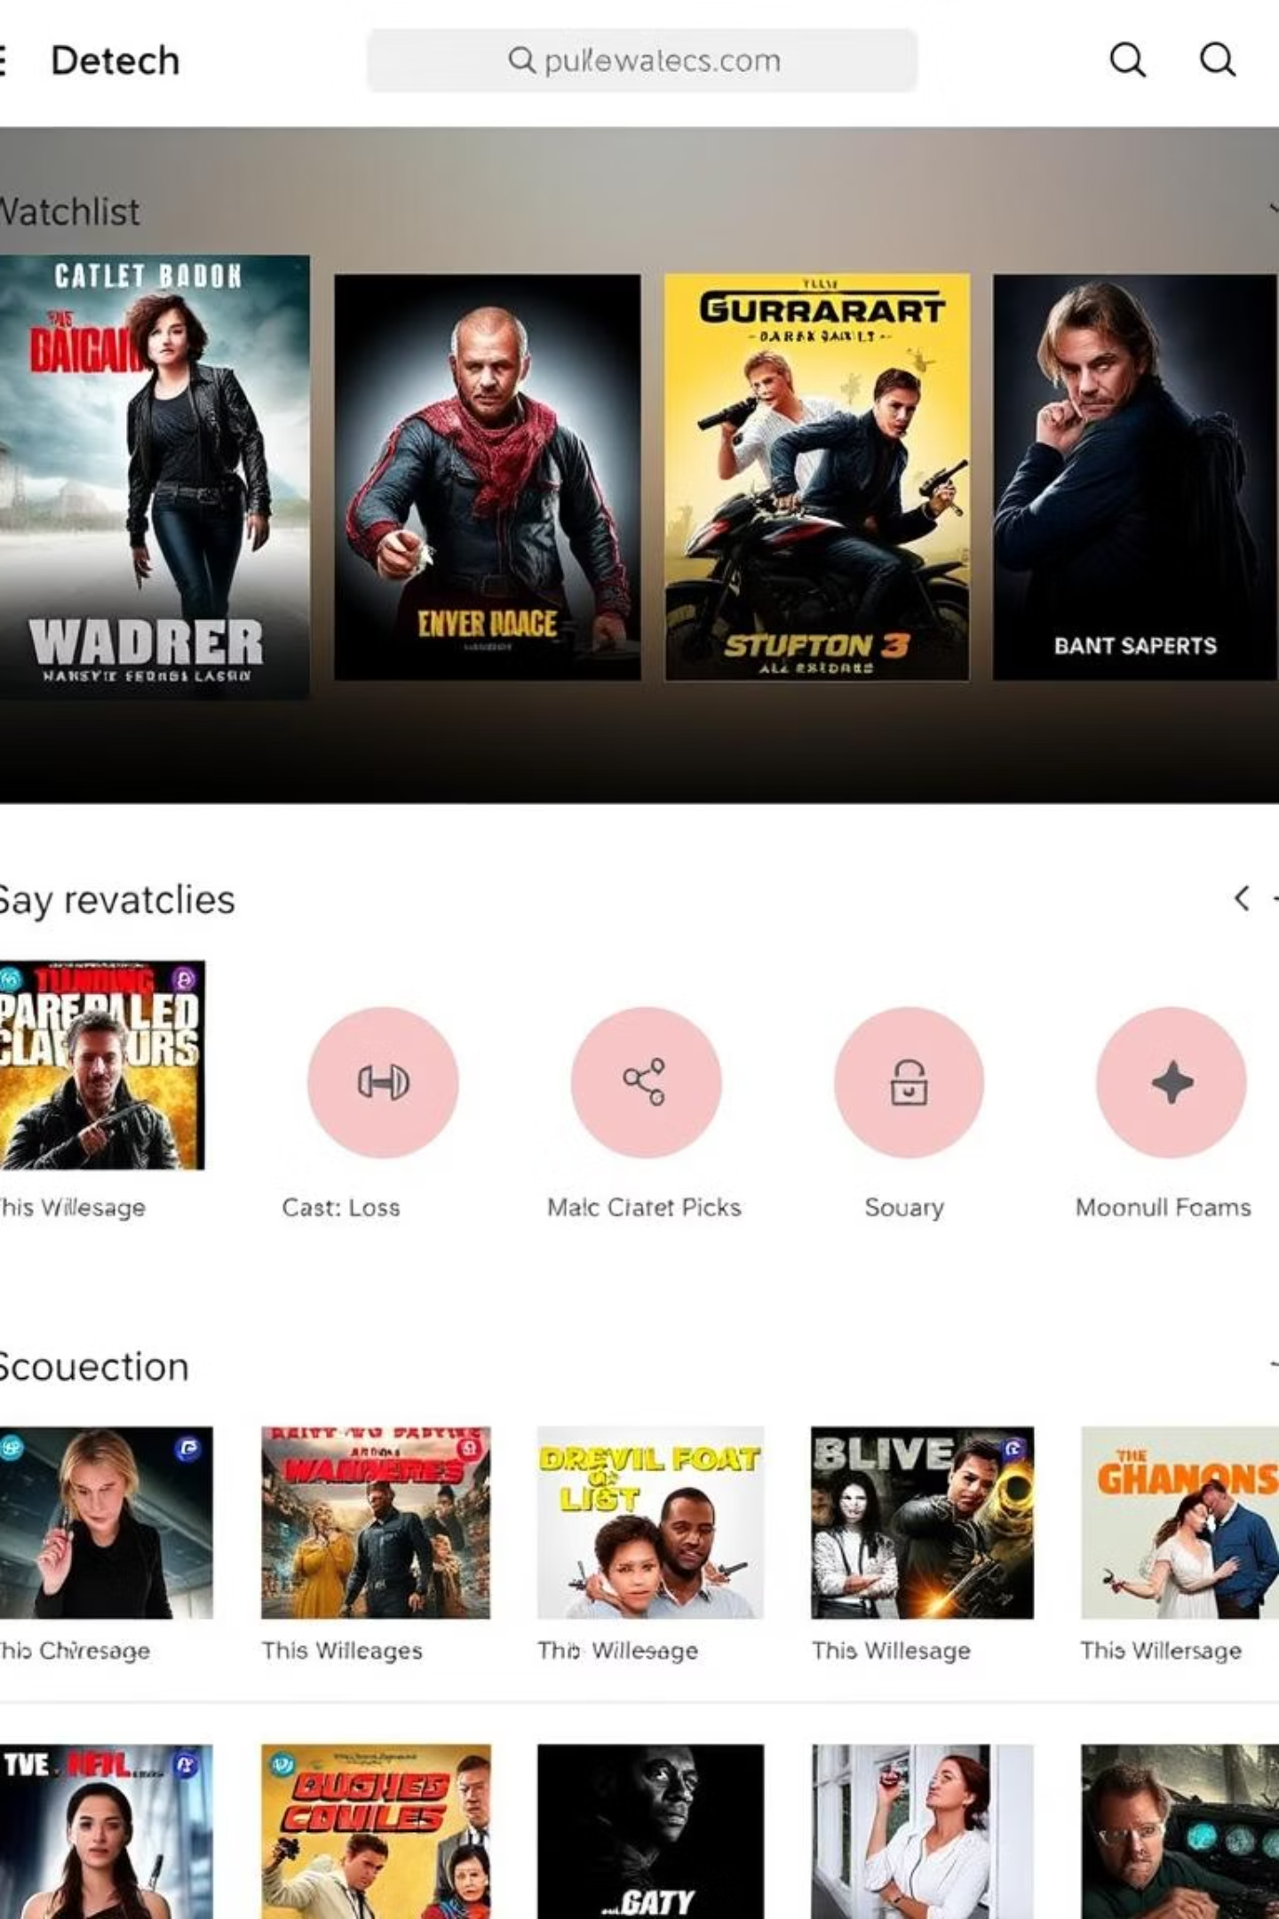
Watchlist Feature
Logged-in users can:
Add movies/shows to their personal watchlist
View, remove, and manage items separately for Movies and TV Shows
Watchlist stored in MongoDB, tied to the user's ID.

Slide 7
Routing & Navigation
Used React Router for SPA experience:
Clean navigation with Link components.
BrowserRouter
Protected routes for authenticated pages (e.g., watchlist).
Routes
Route
useParams
useNavigate
useLocation

Slide 8
Middleware and Backend Logic
Express Middleware:
Mongoose Models
cors
for User, Watchlist.
dotenv
API proxying to secure TMDB calls and hide API key.
express.json() for parsing
jsonwebtoken for token validation
bcrypt for password hashing

Slide 9

Future Improvements (Optional)
Add ratings & reviews from users
Admin panel for content moderation
Recommendation system using user preferences
Dark/light theme toggle

